Slide 1
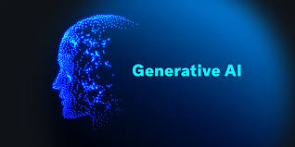

Slide 2
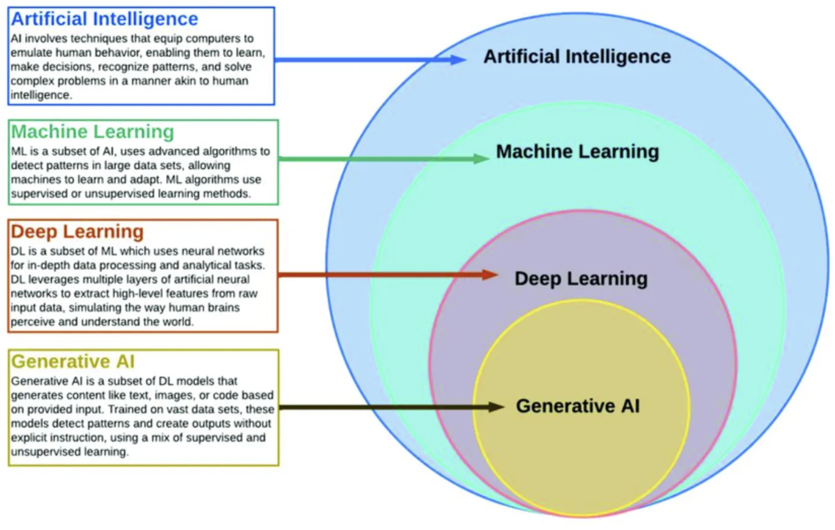

Slide 3
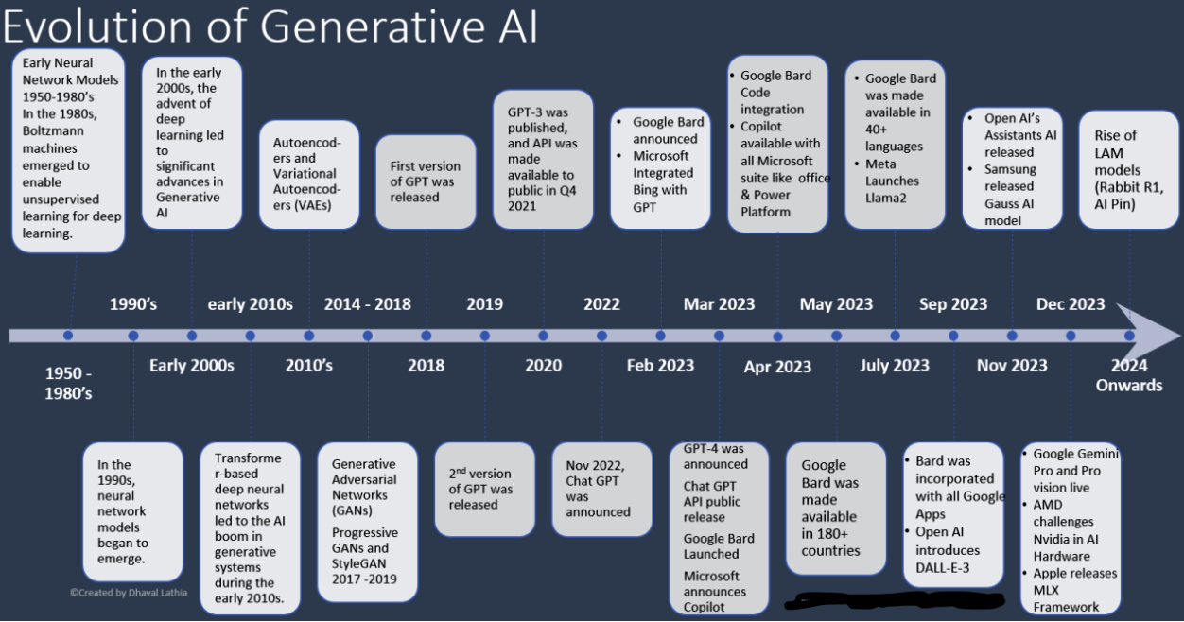

Slide 4
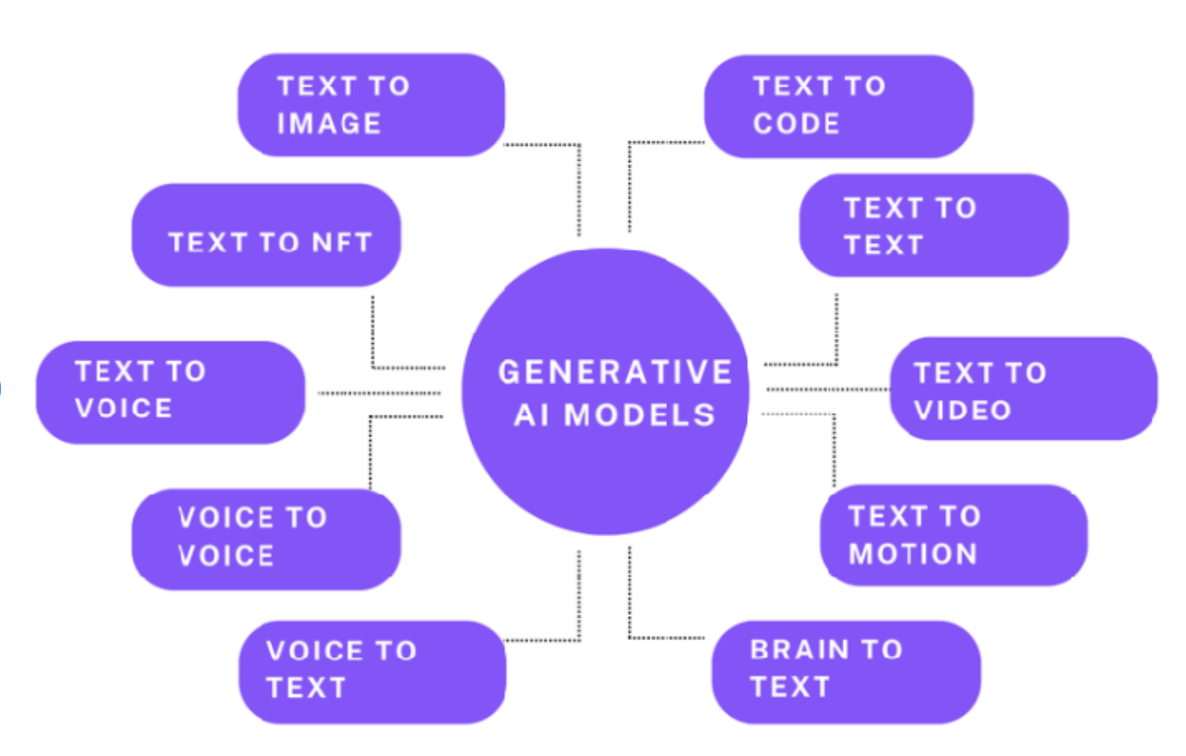

Slide 5
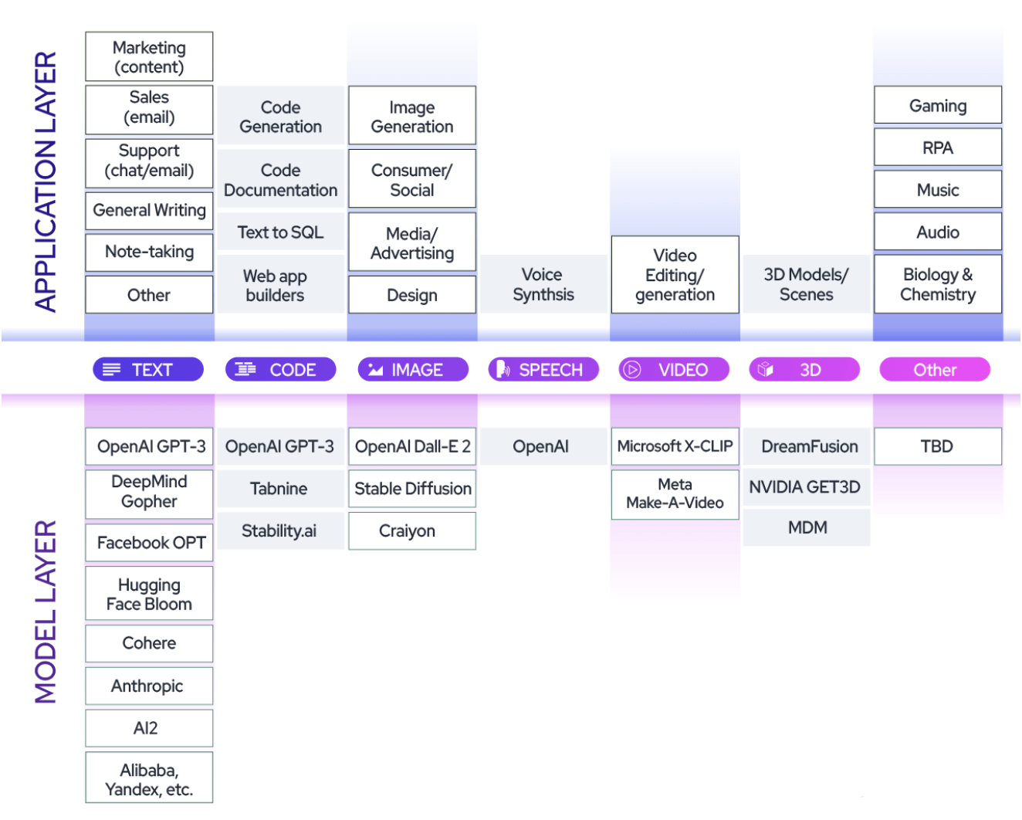

Slide 6
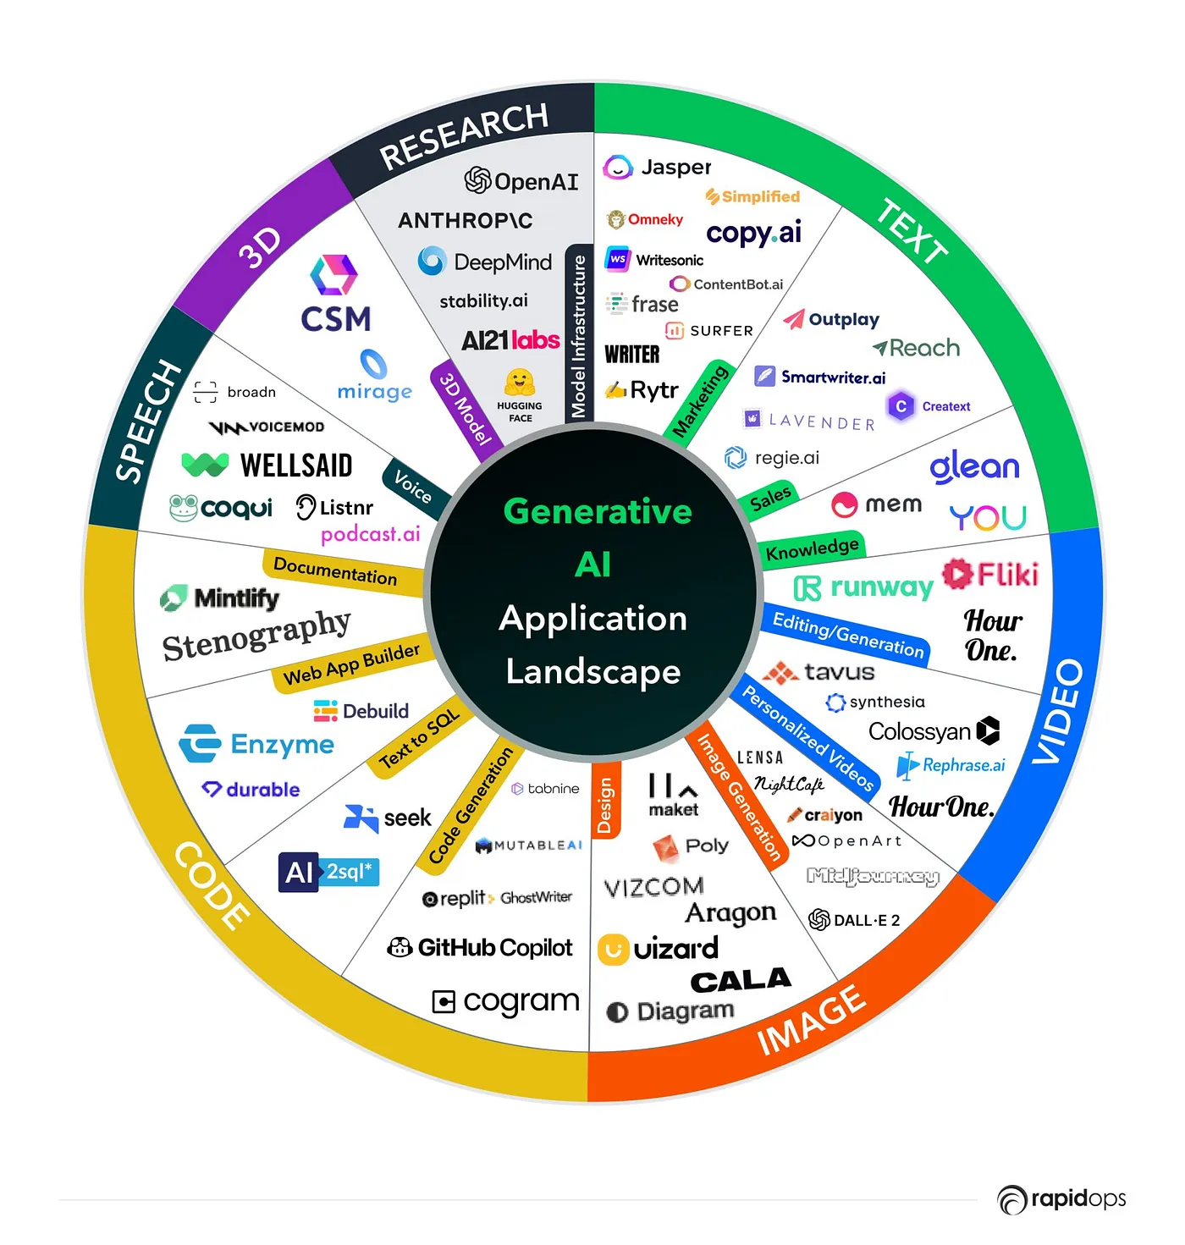

Slide 7
1. RNN (Recurrent Neural Network)
Generates sequences by predicting the next item using memory of previous steps.
2. LSTM (Long Short-Term Memory)
Generates long sequences by remembering important information and forgetting irrelevant parts.
3. GRU (Gated Recurrent Unit)
A simpler LSTM that generates sequences using two gates for fast and efficient memory handling.
4. Autoregressive Model
Generates data one step at a time, where each output depends only on previous outputs.
5. Transformer
Generates sequences using attention to focus on important parts of the input without relying on order.
6. GAN (Generative Adversarial Network)
Generates realistic data by training a generator to fool a discriminator.
7. VAE (Variational Autoencoder)
Generates diverse samples by encoding data into a latent space and decoding it back.
8. Diffusion Model
Generates high-quality images by starting from noise and gradually denoising it step-by-step.

Slide 8
Prompt Engineering
Core Prompt Engineering Techniques
1. Zero-Shot Prompting
Ask the model to perform a task without giving examples.
2. One-Shot Prompting
Provide only one example to guide the model.
3. Few-Shot Prompting
Provide multiple examples to teach the task pattern.

Slide 9
Instruction-Based Techniques
4. Chain-of-Thought Prompting
Ask the model to think step-by-step for better reasoning.
5. Self-Consistency Prompting
Generate multiple reasoning paths and choose the most consistent answer.
6. ReACT Prompting
Combine reasoning + action, used in tool-using agents.
7. Reflexion Prompting
Ask the model to evaluate its own answer and correct it.
Knowledge Control Techniques
8. Retrieval-Augmented Generation (RAG)
Give the model relevant external documents to improve accuracy.
9. Prompt Chaining
Break a task into multiple prompts where each output feeds into the next

Slide 10
Formatting & Structure Techniques
10. Role Prompting
Assign a role like “You are a doctor/teacher/lawyer” to control tone + expertise.
11. Style Prompting
Define style: formal, funny, academic, short, long, emotional, etc.
12. Template Prompting
Use fixed structures such as:
Input:
Process:
Output:

Slide 11
Evaluation & Correction Techniques
16. Verification Prompting
Ask model to double-check facts or calculations.
17. Error Injection Prompting
Intentionally include an error and ask the model to identify and fix it.
Multimodal Prompting
18. Image Prompting
Describe objects, setting, style, lighting, composition.
19. Audio/Video Prompting
Provide detailed descriptions or timestamps for targeted analysis.
Safety & Control
20. Guardrail Prompting
Add constraints to avoid harmful or biased outputs.

Slide 12
Advanced LLM Techniques
21. System Prompting
Use system messages to set global rules that persist across conversation.
22. Hyper-Prompting
Use structured metadata + embeddings to optimize large workflows.
23. Prompt Compression
Shorten long instructions into compact, optimized prompts.
Optimization Techniques
24. Iterative Prompting
Refine prompts repeatedly until the desired output is achieved.
25. Multi-Prompt Voting
Generate answers from multiple prompts → choose best one.

Slide 13
Special Techniques for Generative Tasks
26. Story/Creative Prompting
Use character, plot, tone, context to generate narrative content.
27. Artistic Prompting (for image models)
Define:
Camera angle
Art style
Mood
Color palette
Lighting
28. Negative Prompting (Diffusion models)
Tell model what not to generate (e.g., “no distortion, no blur”).

Slide 14
Generative AI Model
Unimodel : Meta in wtsp : one type of input data and generate same type of output data
Multimodel: can take and generate multiple type of data
For Text Only: ✅ Transformers, RNNs, LSTMs
For Image Only: ✅ VAEs, GANs, Diffusion, ViT
For Both: ✅ Transformers (most versatile)

Slide 15
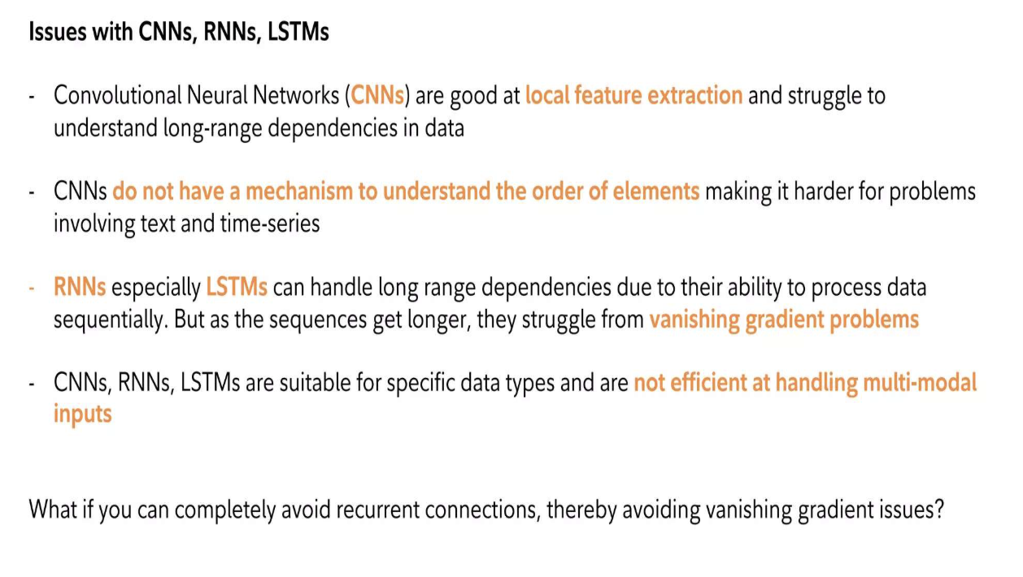

Slide 16
Journey of Generative AI Models
🧪 Phase 1: Foundations (Pre-2014)
Traditional AI/ML models like decision trees, SVMs, and basic neural networks focused on prediction, not generation.
Markov models, n-grams, and RNNs were used for sequence generation (e.g., text/music), but outputs were basic.
⚙️ Phase 2: Rise of Deep Generative Models (2014–2017)
🔹 2014 – Variational Autoencoders (VAEs) by Kingma & Welling
First model to learn probabilistic latent space
Used for blurry but structured image generation
🔹 2014 – Generative Adversarial Networks (GANs) by Ian Goodfellow
Two neural networks (generator vs discriminator)
Produced realistic images, but training was unstable
🔹 2016 – PixelRNN / PixelCNN
Autoregressive models for images, improved sample quality

Slide 17
Phase 3: Attention & Transformers (2017–2020)
🔹 2017 – Transformer architecture (Vaswani et al.)
"Attention is All You Need"
Enabled parallel processing of sequences
🔹 2018 – GPT (1) – OpenAI
First autoregressive transformer for text generation
🔹 2018 – BERT – Google
Masked transformer, not generative but powerful for NLP
🔹 2019 – GPT-2 – Huge leap in natural language generation
🔹 2019 – StyleGAN – SOTA GAN for photorealistic faces

Slide 18
Phase 4: Art, Language & Multimodality (2020–2022)
🔹 2020 – VQ-VAE-2, DALL·E 1 (OpenAI)
Text-to-image generation using discrete VAE + transformers
🔹 2021 – CLIP + DALL·E 2
Combines vision & language for better text-to-image
Enabled semantic understanding of images
🔹 2021 – GPT-3 (175B parameters)
Massive model capable of answering, writing, coding
🔹 2021 – Stable Diffusion, Imagen, Midjourney
Diffusion models created stunning art from text

Slide 19
Phase 5: Foundation & Multimodal Models (2022–2024)
🔹 2022 – ChatGPT (GPT-3.5) and GPT-4
Generative AI moves to the mainstream
Capable of reasoning, coding, dialogue
🔹 2023 – Gemini, Claude, LLaMA, Mixtral, etc.
Focus on open-source, efficiency, and safety
🔹 Multimodal models:
GPT-4-V, Flamingo, Grok, etc. – Understand and generate text + images + audio

Slide 20
Transformer model/Auto Regressive
Submodel | Description
GPT (1, 2, 3, 4) | Generative Pretrained Transformer – text generation
GPT-Neo / GPT-J / GPT-NeoX | Open-source GPT variants
BERT (masked, not strictly generative) | Predicts masked words – semi-generative
Transformer-XL | Long-range dependencies for sequences
XLNet | Permutation-based autoregressive model
PixelRNN / PixelCNN | Image generation pixel by pixel
WaveNet (DeepMind) | Raw audio waveform generation

Slide 21
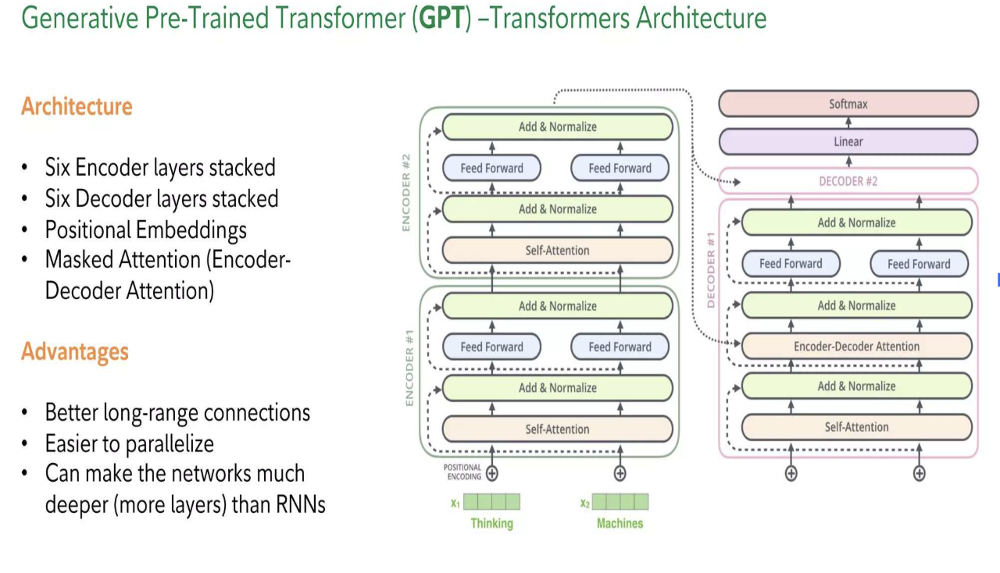

Slide 22
Variational Autoencoders (VAEs)
Submodel | Description
Vanilla VAE | Standard encoder-decoder with probabilistic latent space
Beta-VAE | Adds disentanglement to the latent space
Conditional VAE (CVAE) | Generates data based on conditions (e.g., class labels)
VQ-VAE | Uses vector quantization for discrete latent space (used in DALL·E 1)
FactorVAE | Improves disentanglement compared to Beta-VAE
IntroVAE | Combines VAE and GAN features

Slide 23
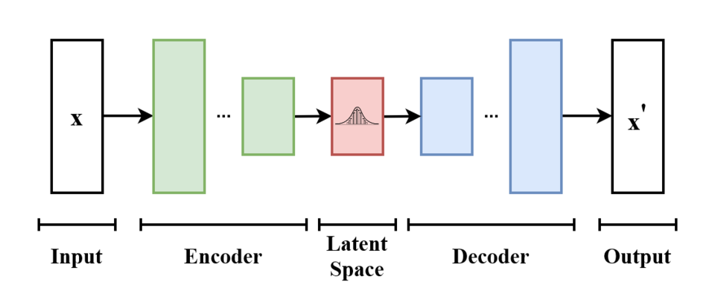

Slide 24
Generative Adversarial Networks (GANs)
Submodel | Description
DCGAN | Deep Convolutional GAN – baseline GAN for images
WGAN / WGAN-GP | Improves GAN training stability using Wasserstein loss
StyleGAN (1, 2, 3) | High-quality face and art generation
CycleGAN | Image-to-image translation (e.g., horse → zebra)
Pix2Pix | Supervised image-to-image generation
BigGAN | High-quality large-scale image generation
Progressive GAN | Progressive resolution learning for large images
Text-to-Image GAN (e.g., StackGAN) | Generate images from captions
Dall.E, Deep fake

Slide 25
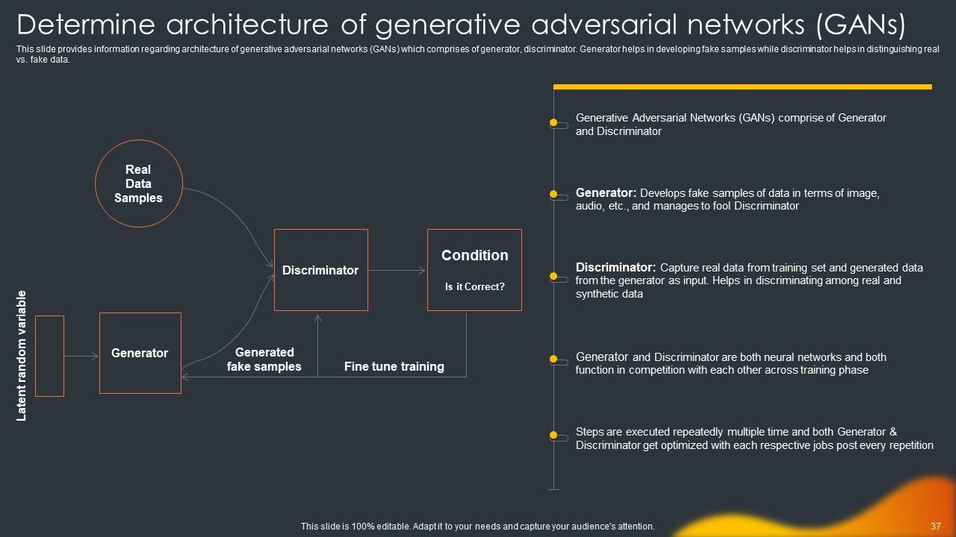

Slide 26
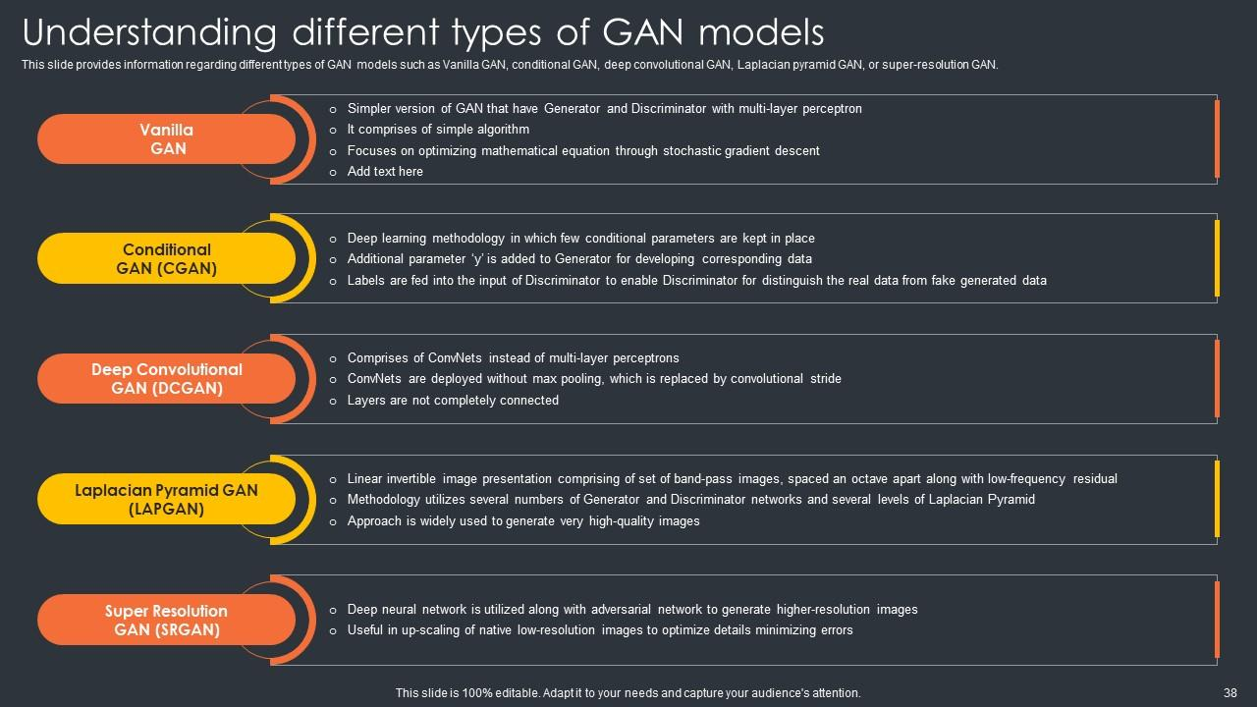

Slide 27
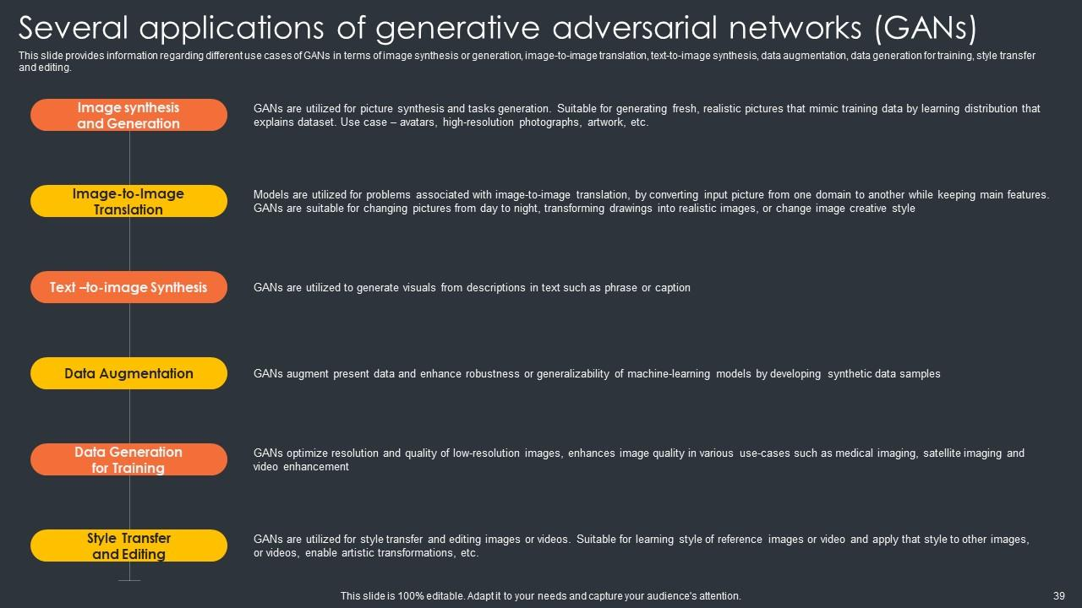

Slide 28
Diffusion Models
Submodel | Description
DDPM (Denoising Diffusion Probabilistic Models) | Foundational diffusion model
Improved DDPM | Training and sampling optimizations
Stable Diffusion | Popular open-source diffusion model
DALL·E 2 | Combines CLIP + diffusion for text-to-image
Imagen (Google) | High-quality text-to-image model
GLIDE (OpenAI) | Guided diffusion with text/image conditioning
Midjourney | Commercial diffusion-based image generator
ControlNet | Adds control and conditioning to diffusion models

Slide 29
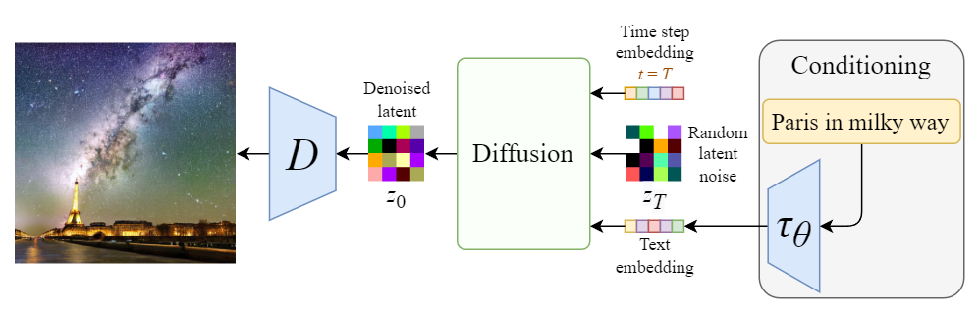

Slide 30
Hugging face:
install transformers library
import the model class and tokenizer/feature extractor.
Load a pre-trained model by name
Preprocess input (text/image/audio).
Feed input into model → get output.
Use Case | Use this class/pipeline
Sentiment analysis | pipeline("sentiment-analysis")
Text generation | pipeline("text-generation")
Fill-in-the-blank | pipeline("fill-mask")
Question answering | pipeline("question-answering")
Summarization | pipeline("summarization")
Translation | pipeline("translation_xx_to_yy")
Zero-shot classification | pipeline("zero-shot-classification")
Named Entity Recognition | pipeline("ner")
Image classification | pipeline("image-classification")

Slide 31
Model | Focus | Strength | Weakness
RNN | Sequences | Remembers previous steps | Short memory, vanishing gradients
LSTM | Sequences | Longer memory, solves RNN limits | Slower, complex
GRU | Sequences | Like LSTM but simpler | Less expressive than LSTM
Autoregressive | Sequences (predict next) | Generates sequence step by step | Can’t parallelize training
Transformer | Sequences + parallel | Long context, parallel training | Big model, needs data
GAN | Generation (images) | Realistic image synthesis | Hard to train, unstable
VAE | Generation (latent space) | Learn smooth latent space | Blurry outputs sometimes
Diffusion | Generation (iterative noise) | Very high-quality images | Slow sampling (improving)

Slide 32
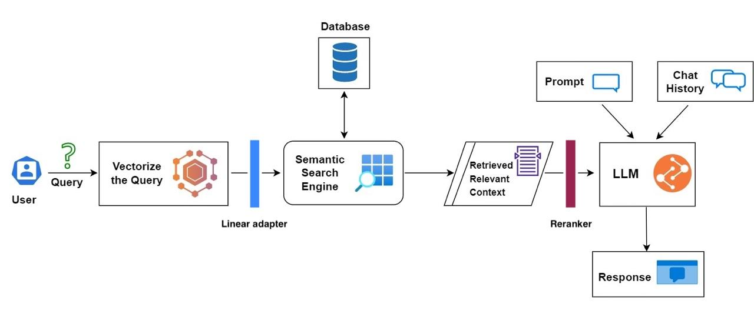

Slide 33
Trends
Multimodal AI
AI Agents
AI Powered Coding : Copilot
RAG
AI Wearable and Embodied AI: Rabbit R1
Brain-Computer Interfaces (BCI) + AI: Elon musk neural link
Explainable AI

